Slide 1
Introduction to Genomic Epidemiology
Theory Module
Slides from Edyth Parker

Slide 2
Outline
What is genomic epidemiology?
Pathogen evolution during spread
Phylogenetic vs transmission trees
Why use genomic epidemiology?
Notes:
Not sure about topic titles – let me know what you think
^ made some small tweaks, feel free to change if you don’t like

Slide 3
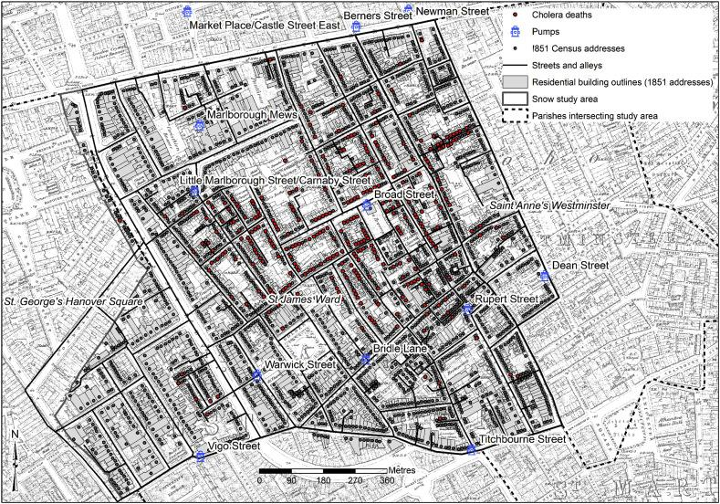
What is epidemiology?
Study of the occurrence and causes of diseases in a population
Approaches include:
Number of cases of disease in a population e.g., geographic area
The frequency of an exposure among cases and non-cases
Outbreak investigations
Newsom et al. 2006.

Slide 4
Limitations of classical epidemiology
Observations associated with many biases and confounders
Large populations needed for statistical power
Labor-intensive and slow
Often retrospective
Limited information on pathogen circulation dynamics

Slide 5
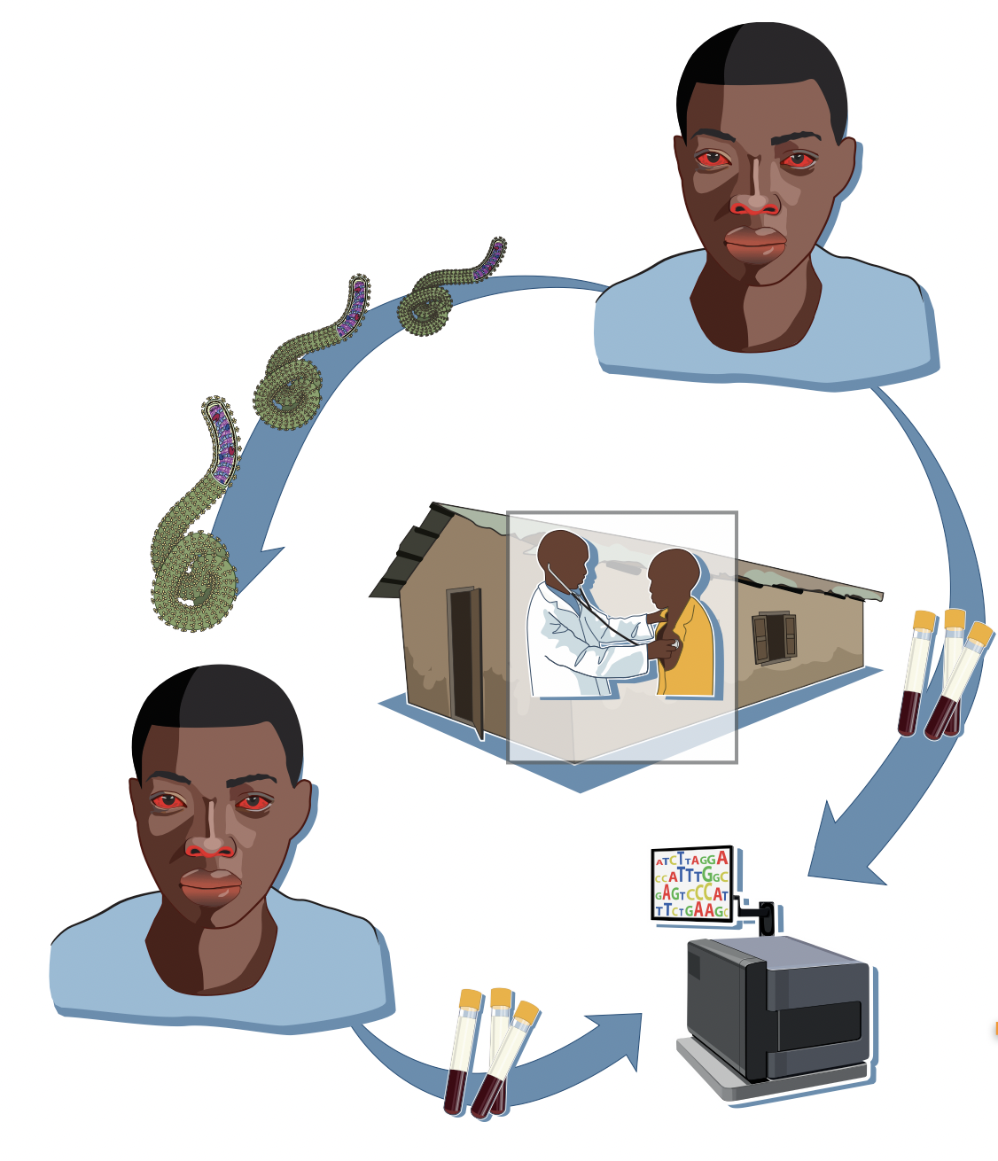
What is pathogen genomic epidemiology ?
Epidemiology of infectious diseases using pathogen sequencing
Sequencing: determining the nucleotide composition of a genome
Genome: the set of genetic information in an organism
Genomic epidemiology is central to infectious disease public health surveillance
Andersen et al. 2015.

Slide 6

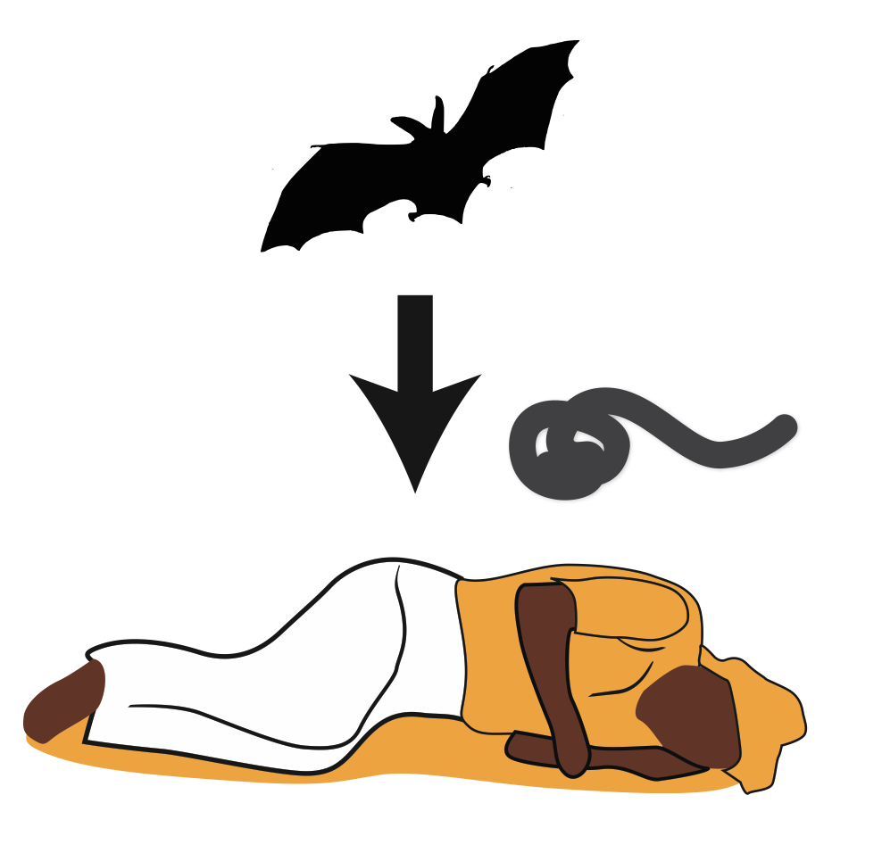
Why use genomic epidemiology?
What is the pathogen?
What is the reservoir?
How many introductions from reservoir?
1. Identify the origin of epidemics/zoonoses
Notes:
Removed some words here that I thought were redundant, feel free to change back if you don’t agree

Slide 7
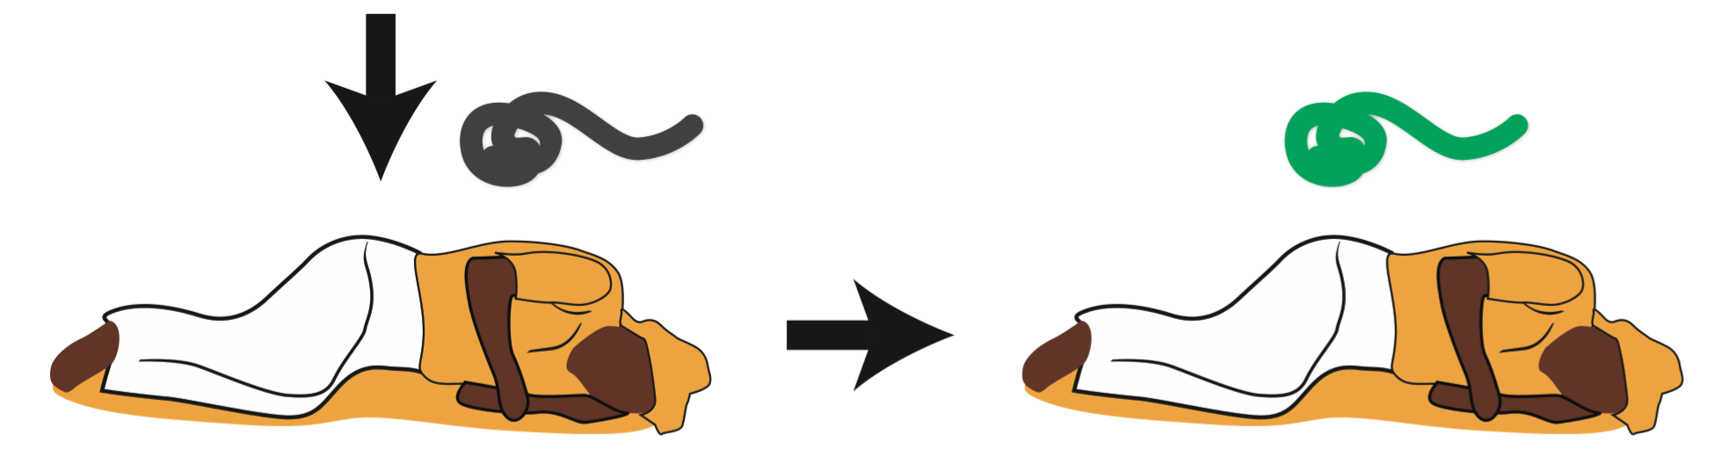
Why use genomic epidemiology?
2. Understand transmission dynamics
Are cases linked to one another?
Is there evidence for human-to-human transmission?
When did the pathogen enter the population of interest?
From where was it introduced?
How is the pathogen evolving as it spreads?

Slide 8
Outline
What is genomic epidemiology?
Pathogen evolution during spread
Phylogenetic vs transmission trees
Why use genomic epidemiology?
Notes:
Added the outline again here to aid transition, feel free to remove if it doesn’t make sense when writing script

Slide 9
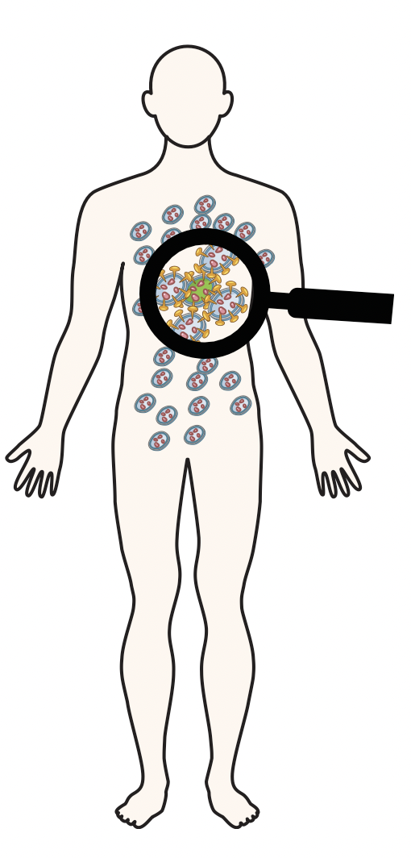

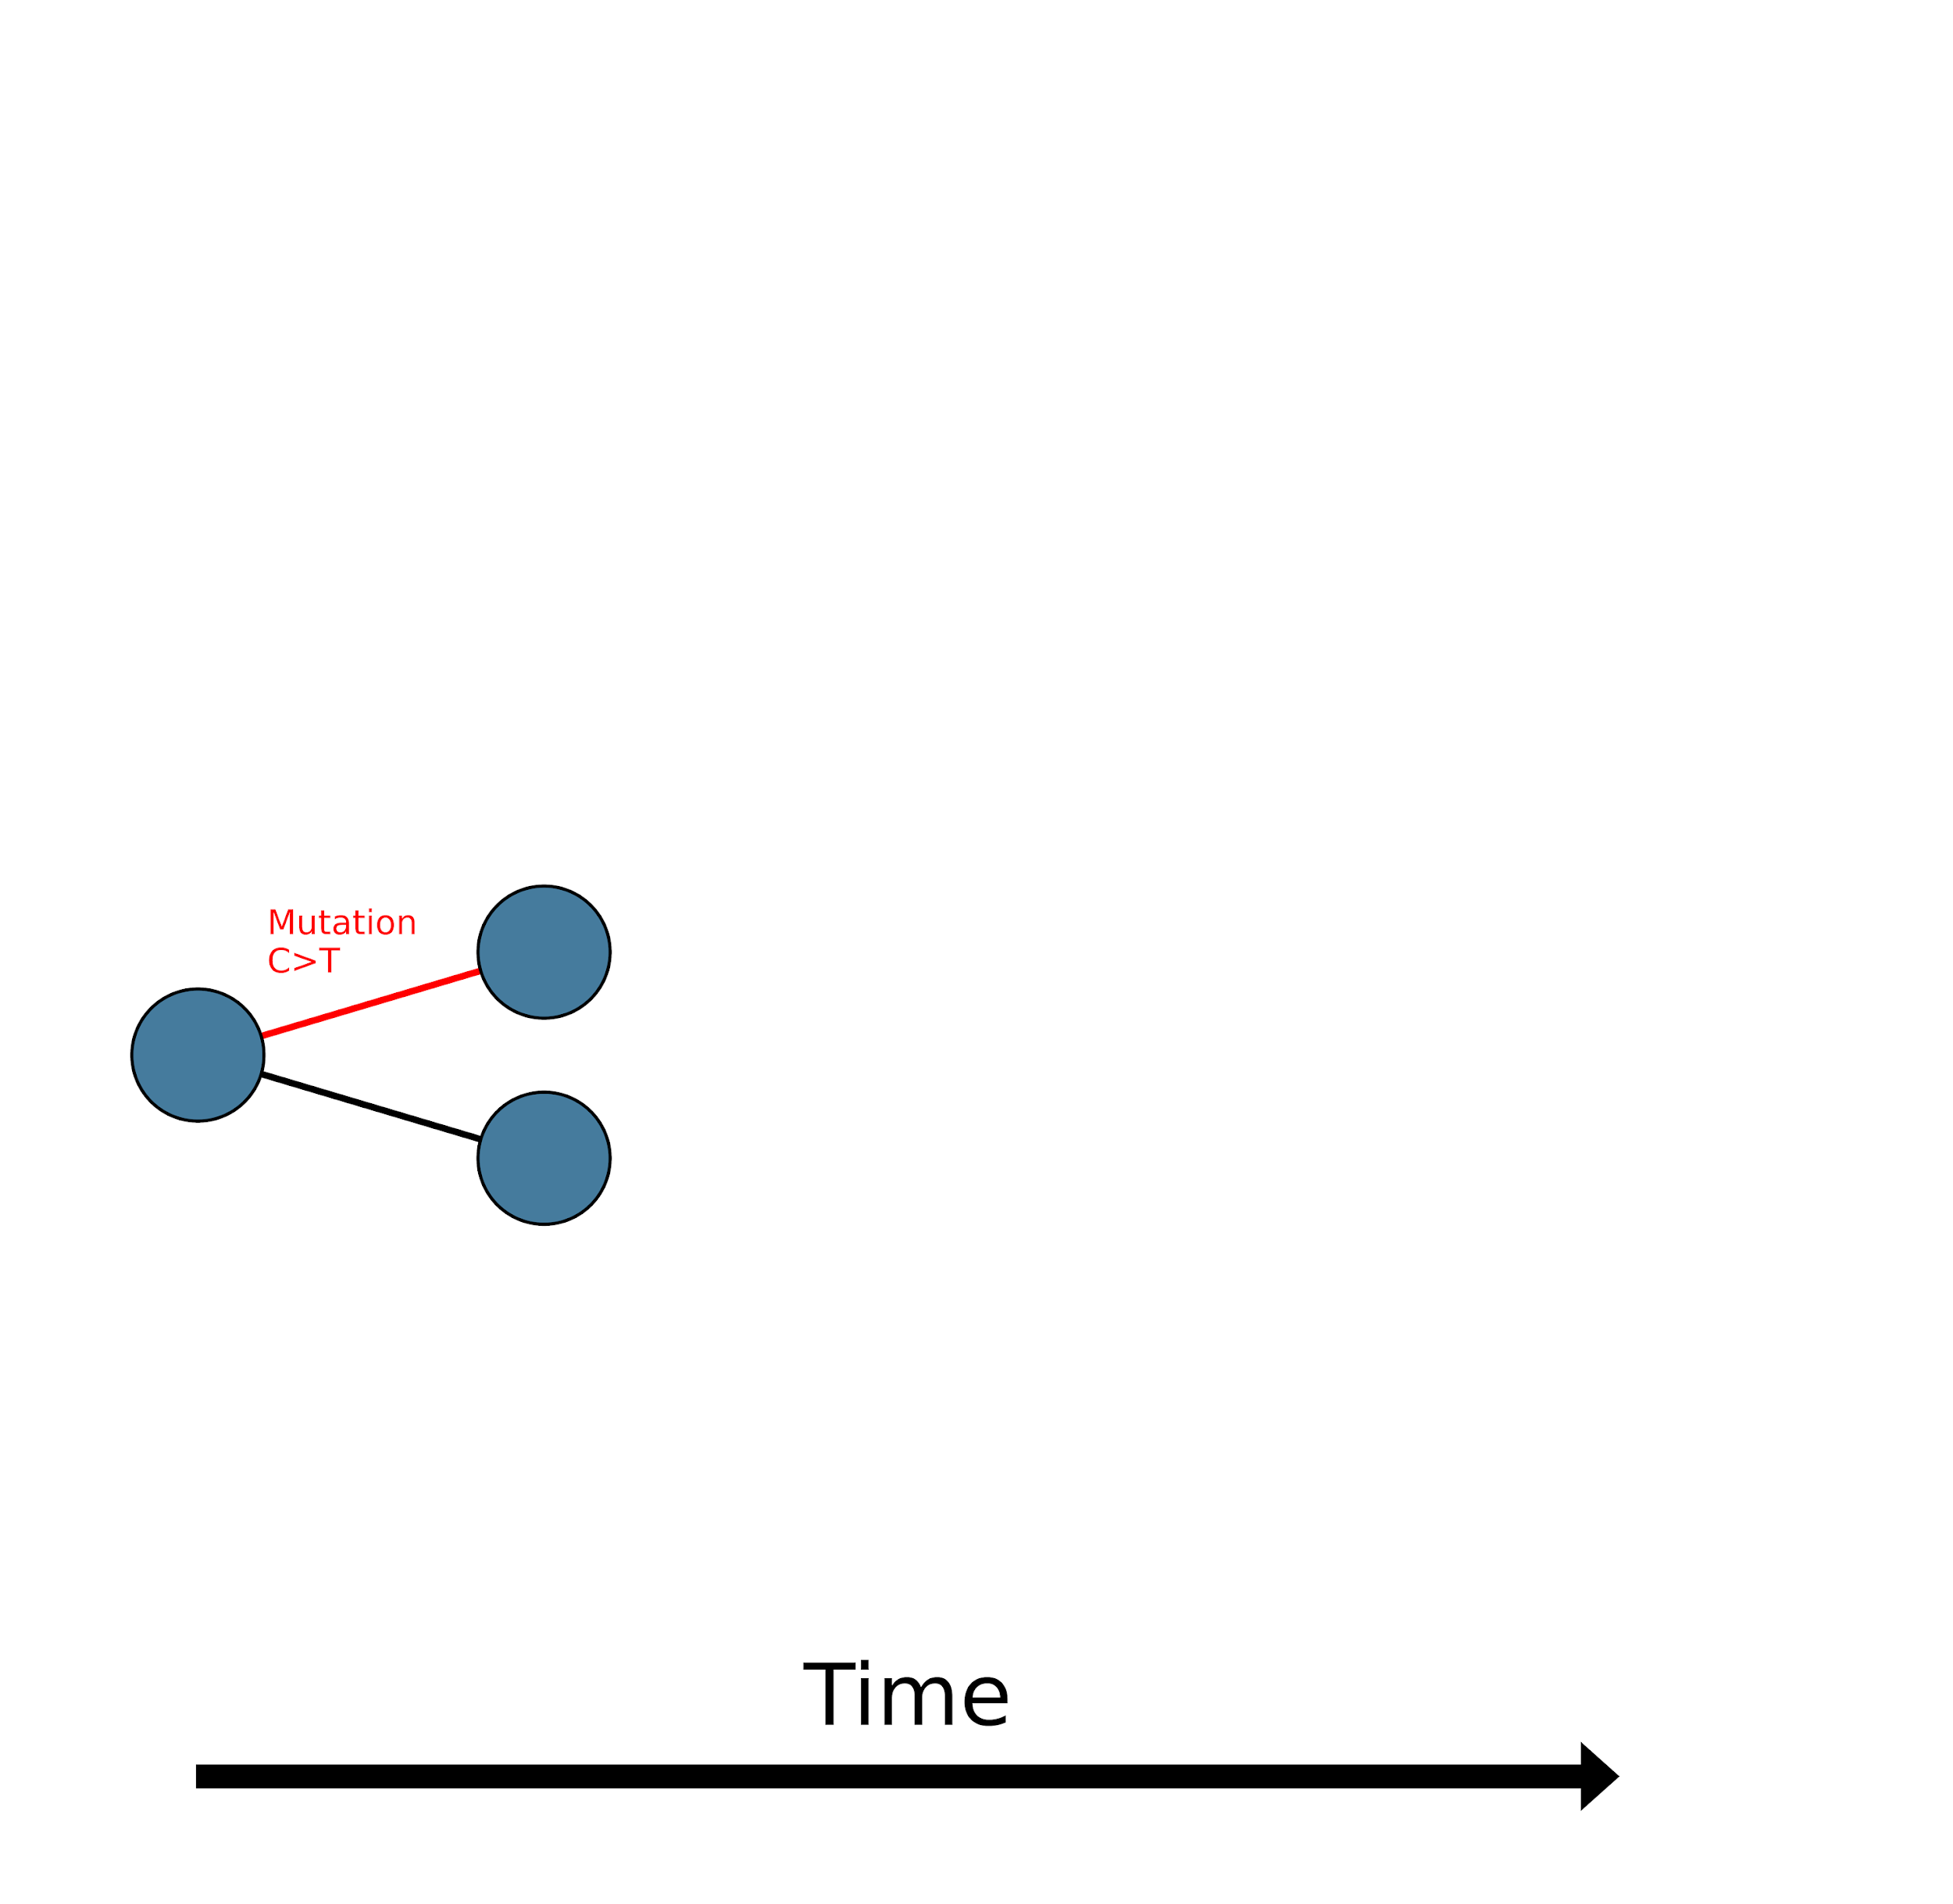
Mutations occur randomly and naturally
Some mutations are transmitted, others are not
…
Notes:
Do all of these images meet our copyright requirements?
What exactly is this image trying to show? The person on the right looks the same as the left? Maybe we can discuss an alternate image that is clearer?
Would it be helpful to introduce this concept around slide 10 when you mention mutations accumulate?

Slide 10
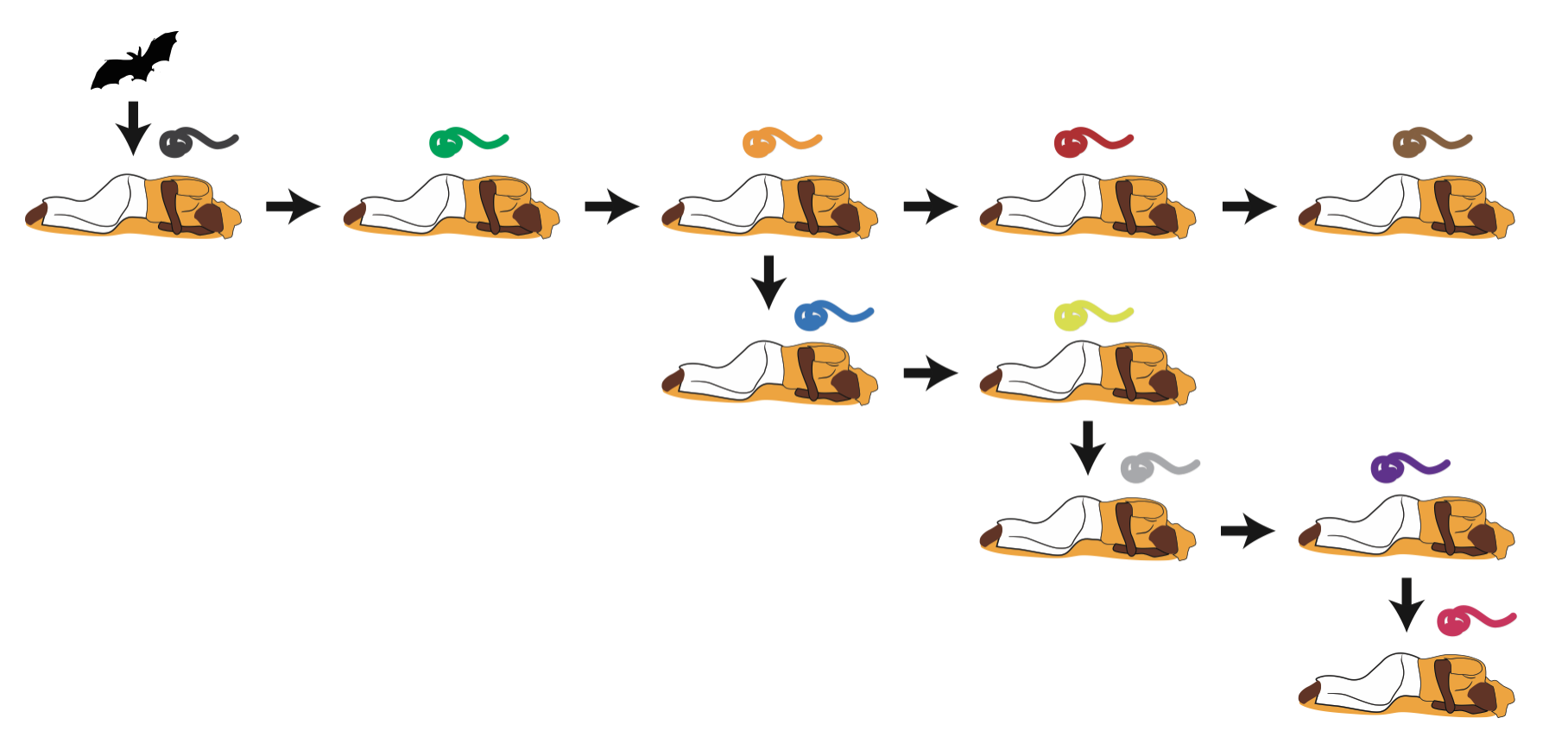
Pathogen genome evolution during spread
The pathogen evolves as it spreads between hosts
Time

Slide 11
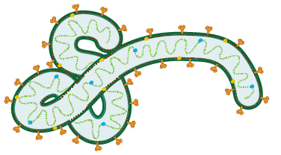
Pathogen genome evolution during spread
Mutations accumulate in the pathogen genome
ATGCAGCTAGCTGATGCTGACTGACTGACTG

Slide 12
Pathogen genome evolution during spread
Pathogen sequencing allows us to track evolution during spread
Patient 1 transmits to patient 2
Samples collected from patient 1
Samples collected from patient 2
Samples from patients
sequenced and compared
Andersen et al. 2015.

Slide 13
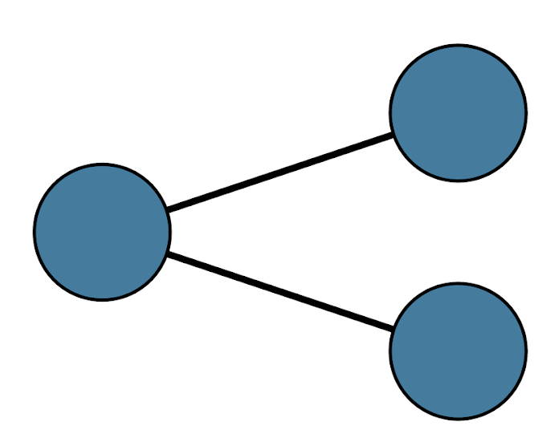
Pathogen genome evolution example
A pathogen is spreading in the population

Slide 14
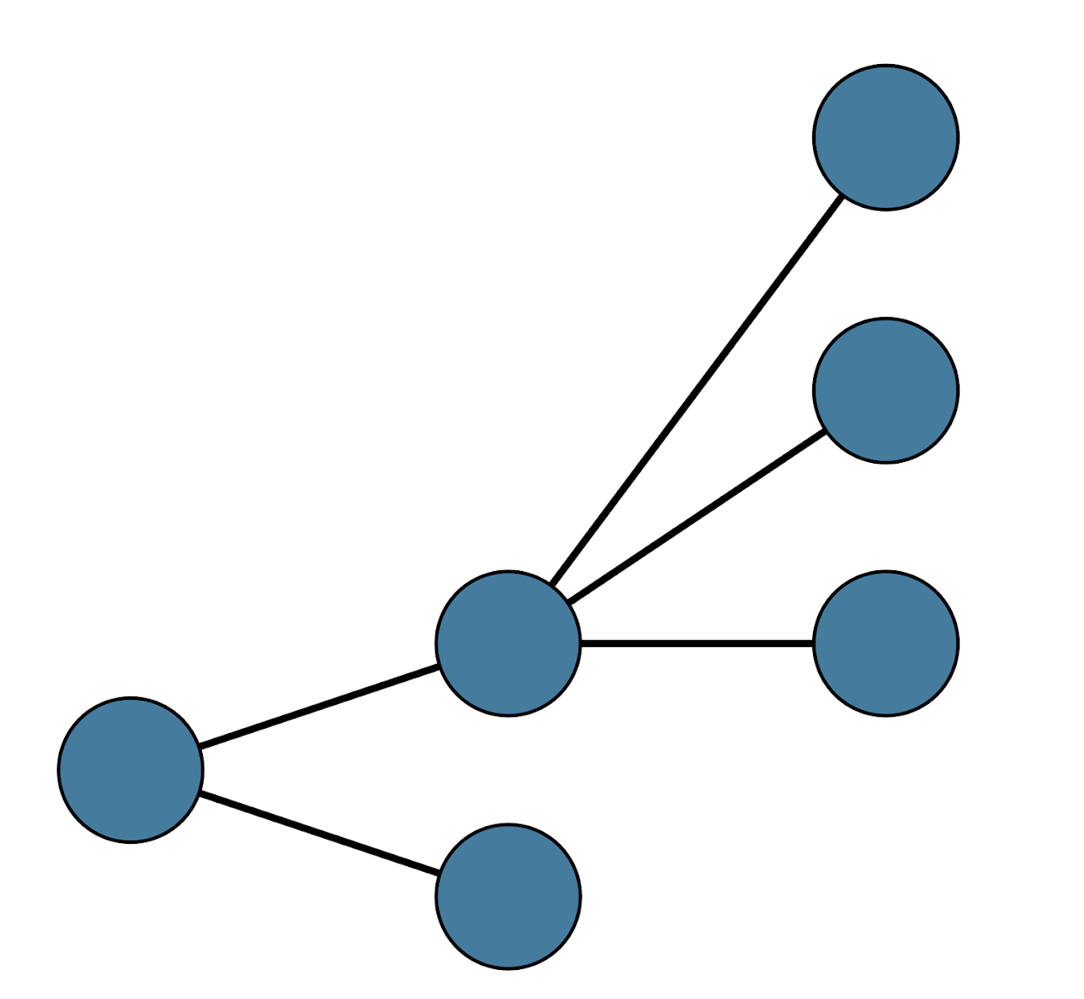
Pathogen genome evolution example
A pathogen is spreading in the population

Slide 15
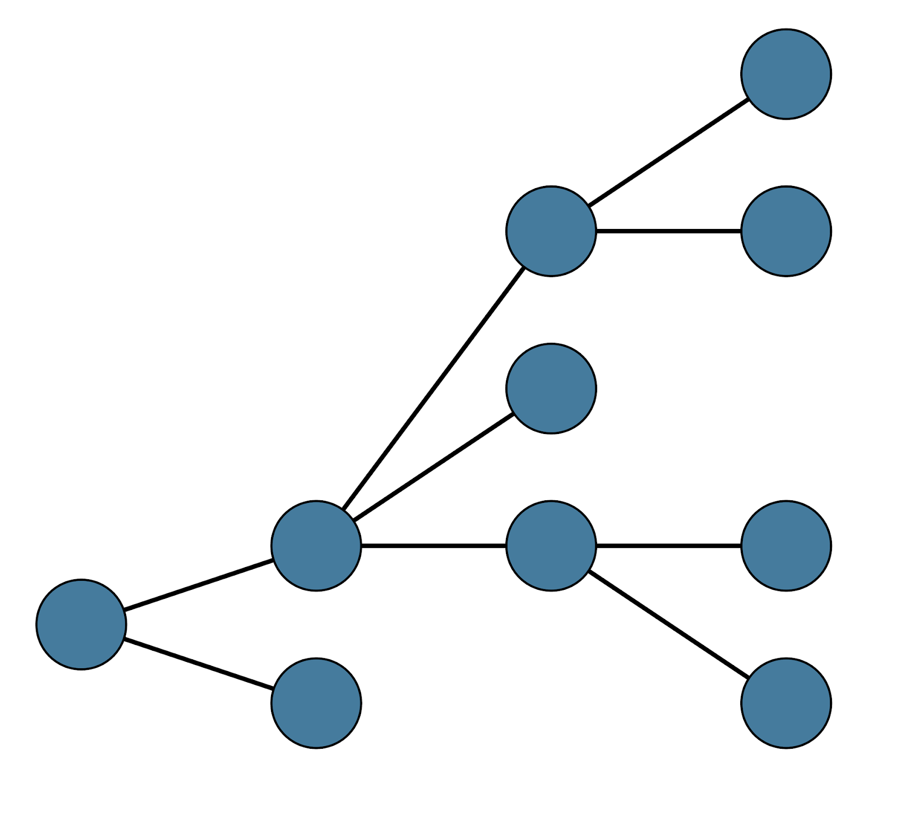
Pathogen genome evolution example
A pathogen is spreading in the population

Slide 16
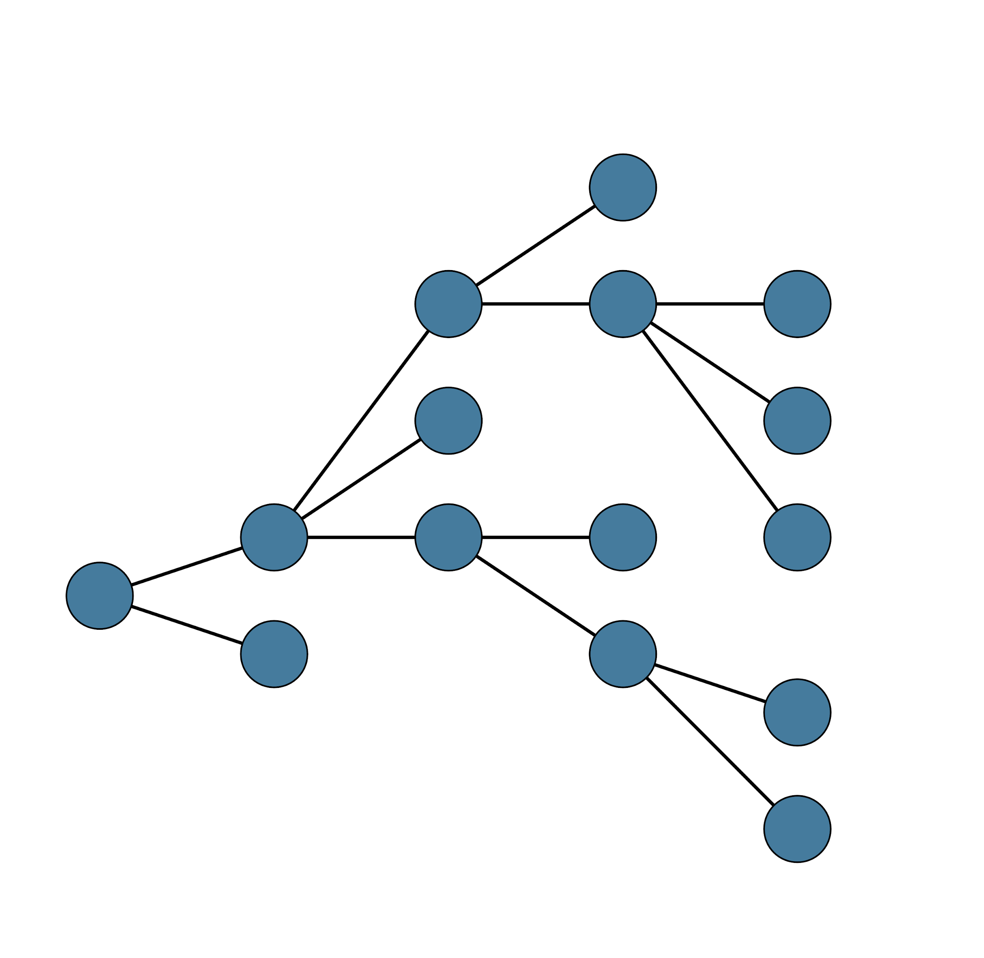
Pathogen genome evolution example
A pathogen is spreading in the population

Slide 17
Pathogen genome evolution example
Tracking mutations during pathogen spread
ATGCCAGCTA
ATGCCAGCCA
Time

Slide 18
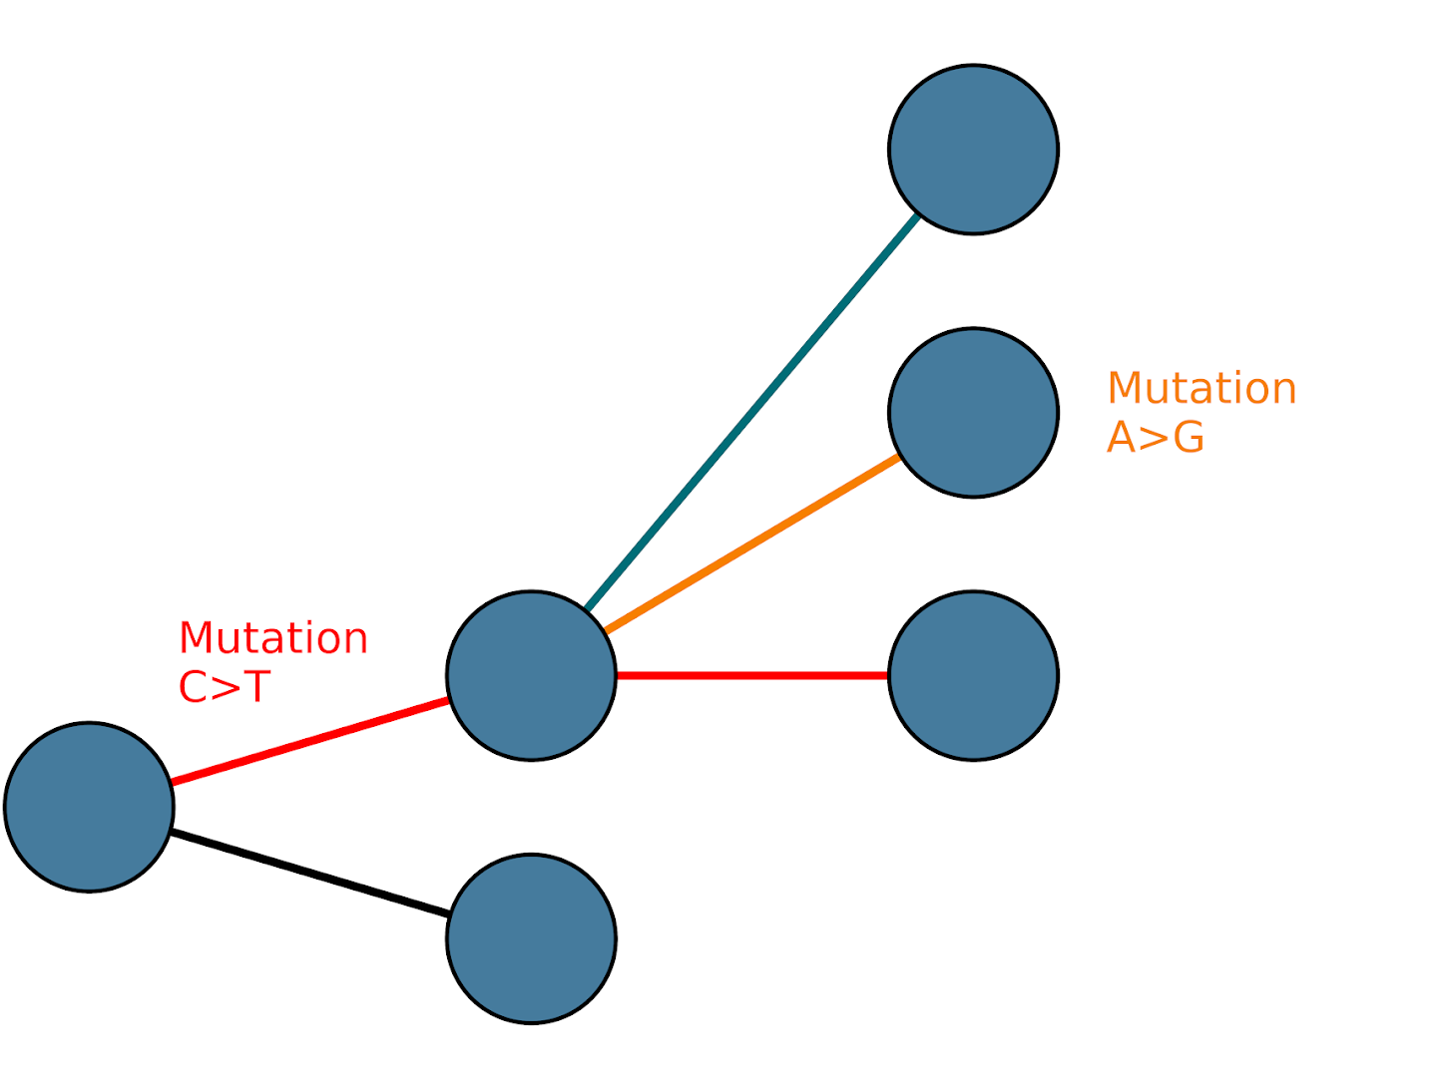
Pathogen genome evolution example
Tracking mutations during pathogen spread
ATGCCGGCTA
ATGTCAGCTA
ATGCCAGCCA
Time
Notes:
Should there be another label (mutation C>T) on the other circle connected by a red line?

Slide 19
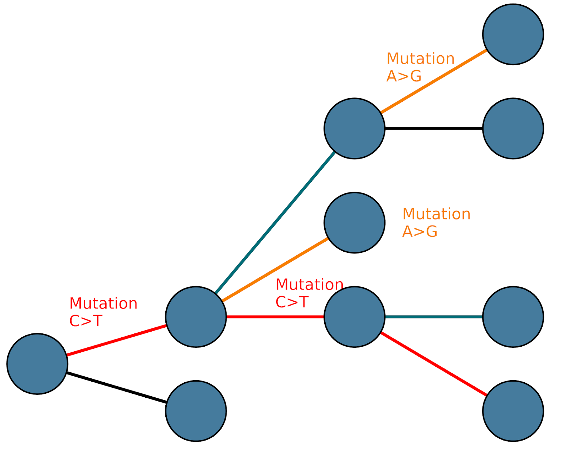
Pathogen genome evolution example
Tracking mutations during pathogen spread
GTGCCAGCTA
ATGCCAGCCA
ATGTTAGCTA
Time
Notes:
Should there be another label (mutation C>T) on the other circle connected by a red line?

Slide 20
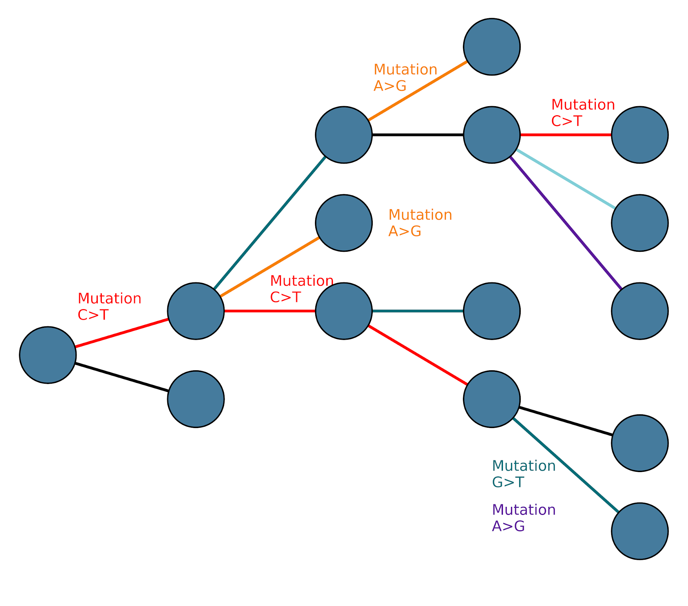
Pathogen genome evolution example
Tracking mutations during pathogen spread
ATGTCAGCTA
ATGCCAGCCA
GTTTTAGCTA
Time
Notes:
Should there be another label (mutation C>T) on the other circle connected by a red line?

Slide 21
Pathogen genome evolution example
Tracking mutations during pathogen spread
ATGTCAGCTA
Not all cases are observed, sampled, or sequenced
ATGCCAGCCA
GTTTTAGCTA
Time
Notes:
Should there be another label (mutation C>T) on the other circle connected by a red line?

Slide 22
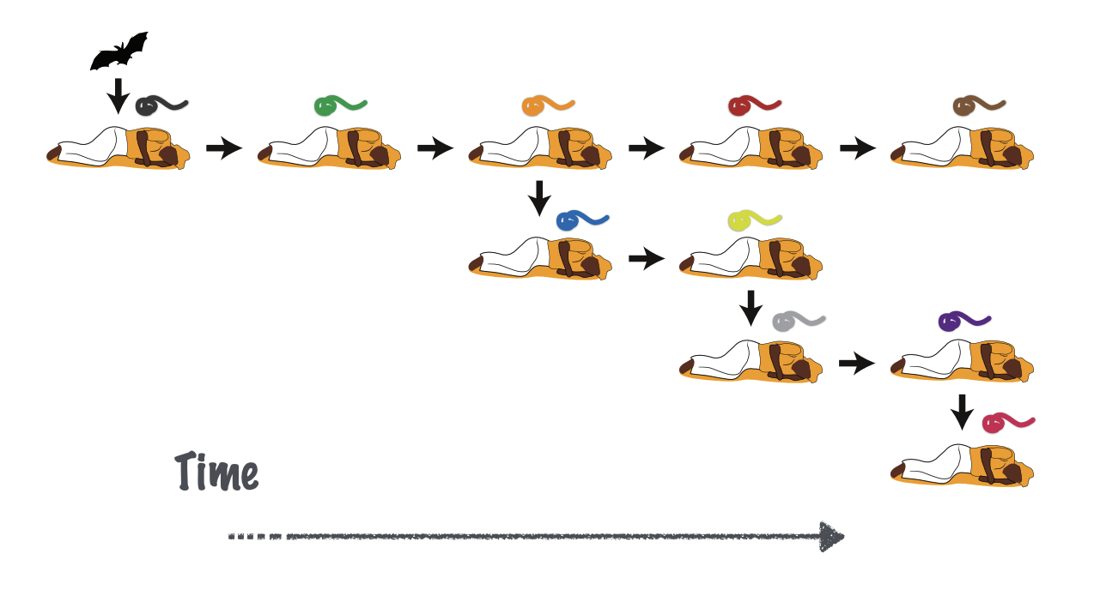
Pathogen genome evolution example
Recovered
Recovered
Deceased
Deceased
Hospital
Doctor
Hospital
Hospital

Slide 23
Pathogen genome evolution example
Recovered
Recovered
Deceased
Deceased
Hospital
Doctor
Sampled
Sampled
Hospital
Hospital
Sampled

Slide 24
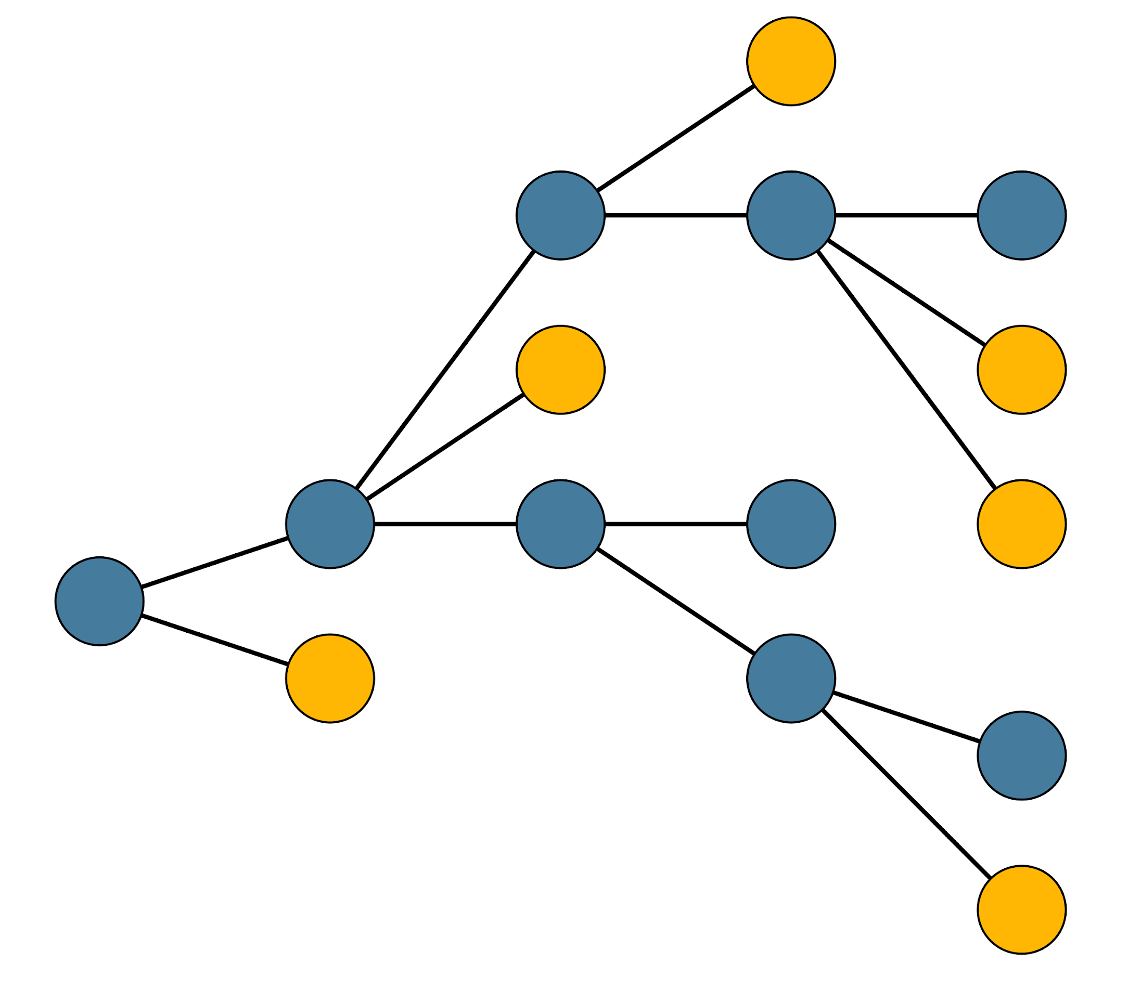
Pathogen genome evolution example
Recovered
Recovered
Deceased
Deceased
Hospital
Doctor
Sampled
Sampled
Hospital
Hospital
Sequenced
Sampled
Sequenced

Slide 25
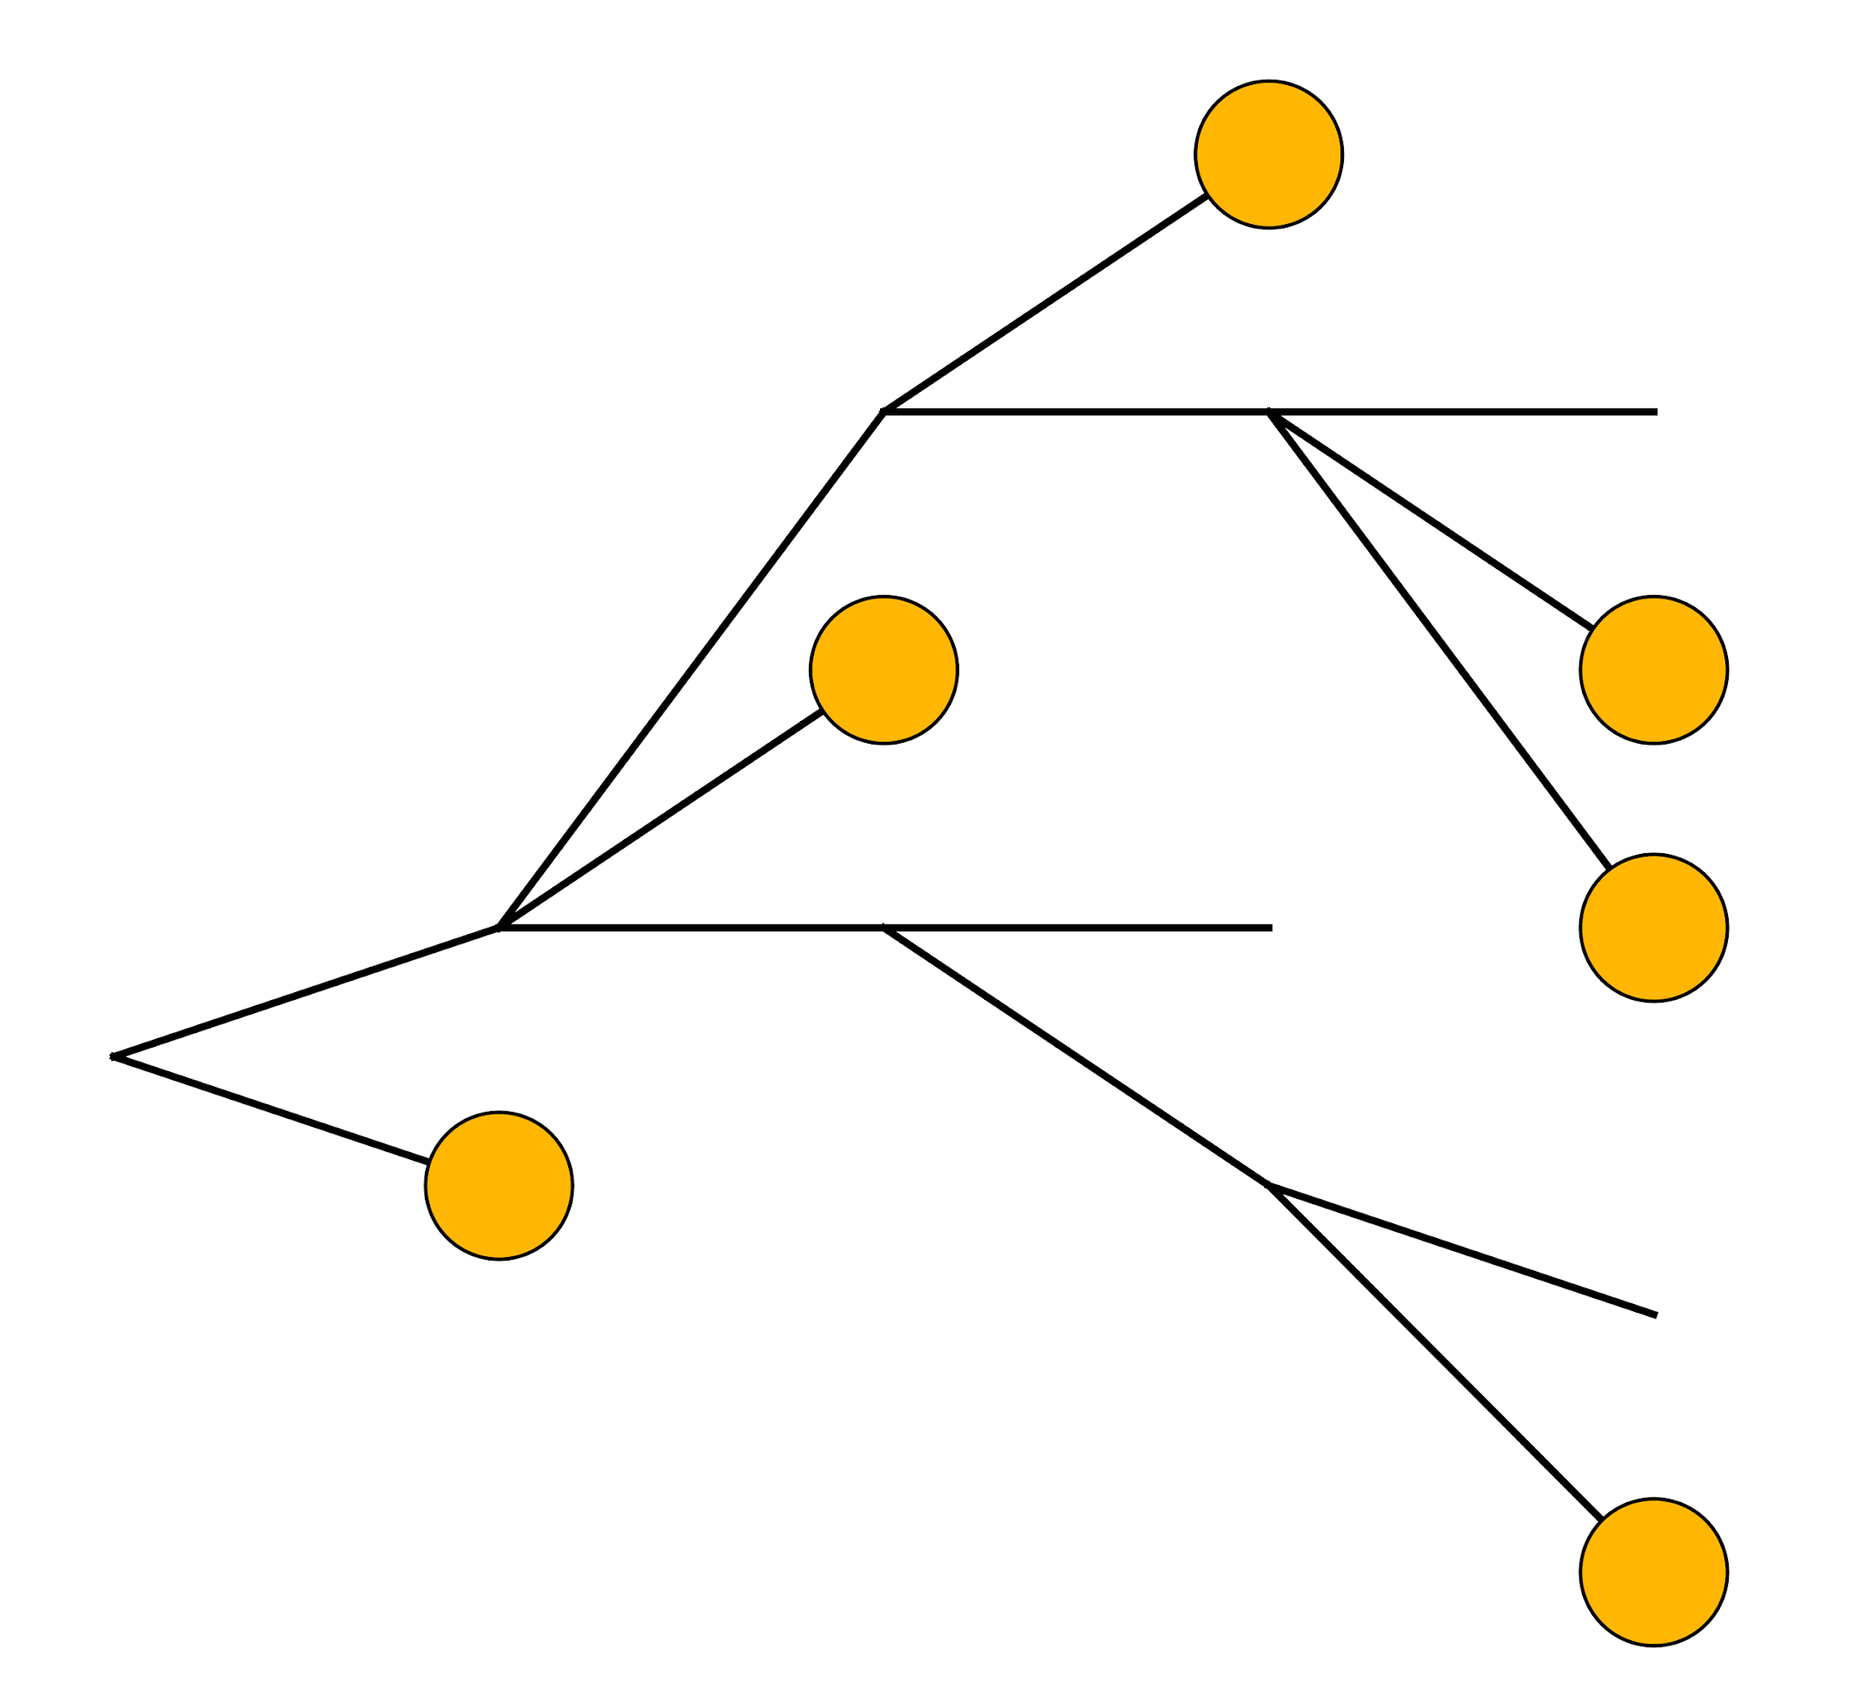
Pathogen genome evolution example
Only some cases in a transmission chain are sequenced

Slide 26
Outline
What is genomic epidemiology?
Pathogen evolution during spread
Phylogenetic vs transmission trees
Why use genomic epidemiology?
Notes:
Added the outline again here to aid transition, feel free to remove if it doesn’t make sense when writing script

Slide 27
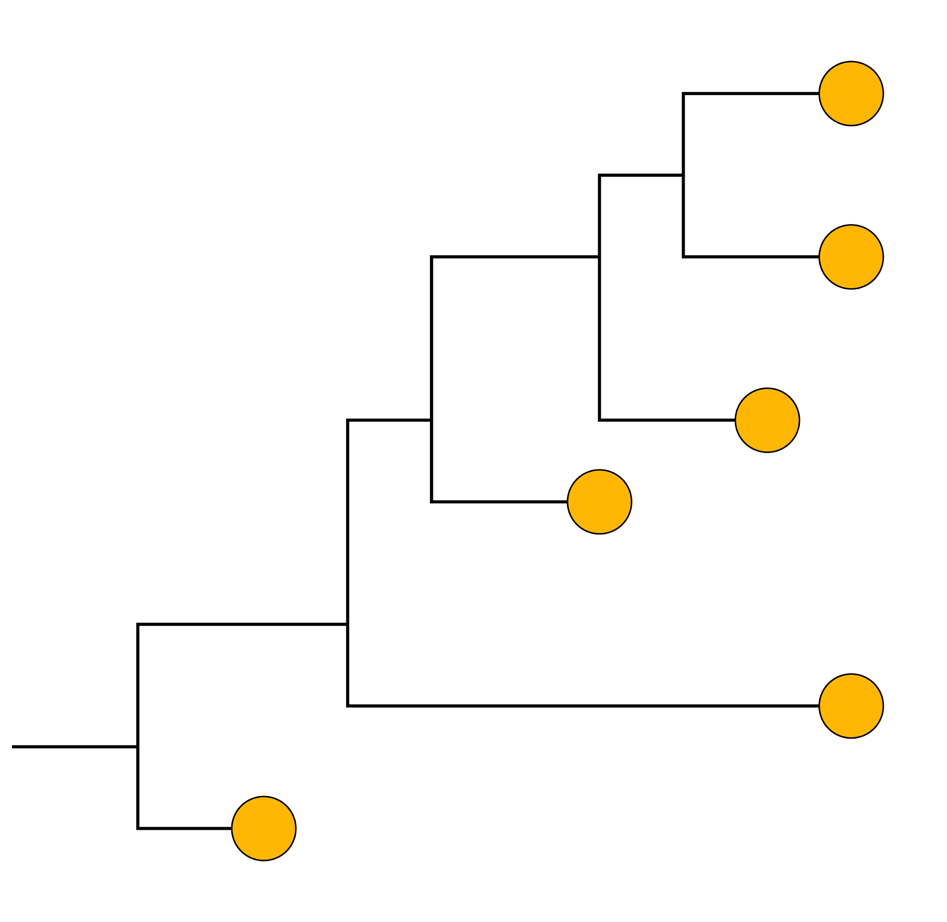
Phylogenetic trees are not transmission trees
Phylogenies reconstruct the evolutionary relationships between pathogens
Phylogenetic tree
Transmission tree
Notes:
phylogenetic trees are not transmission trees
In a transmission tree
>Topology: structure of relationships
>Branch lengths: amount of evolutionary change (or time)
Average expected number of substitutions per site

Slide 28
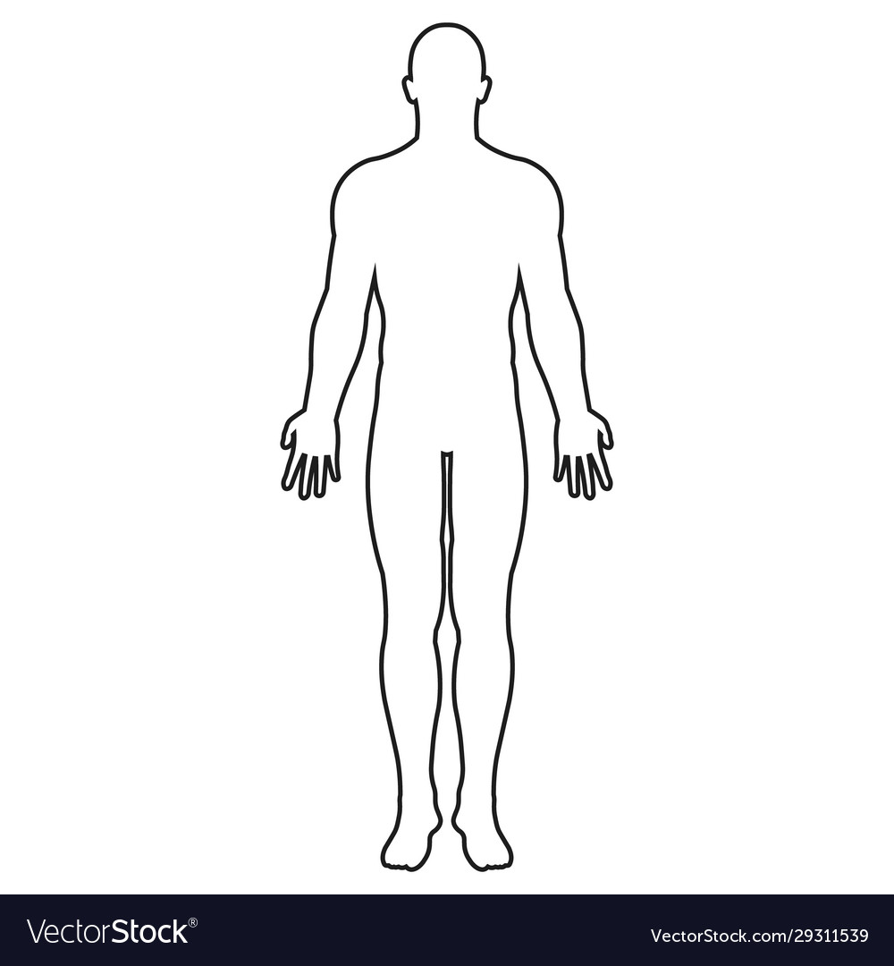
Reconstructing the phylogeny
C
GTCTCGGCTC
G
T
GTGTCGGCTA
0.02
GTGTCAGCTA
GTGCCAGCTA
G
0.07
G,T
GGGCCATCTA
ATGTCAGCTA
Notes:
Topology: structure of relationships
Branch lengths: amount of evolutionary change (or time)
Average expected number of substitutions per site
> zooming on the phylogeny for this specific example
> A phylogenetic tree details the relationship between the sequences from patients
In this figure the horizonal dimension gives the amount of genetic change.
The horizontal lines are branches and represent evolutionary lineages changing over time.
The longer the branch in the horizontal dimension, the larger the amount of change.
The bar at the bottom of the figure provides a scale for this.
In this case the line segment with the number ‘0.07’ shows the length of branch that represents an amount genetic change of 0.07.
The units of branch length are usually nucleotide substitutions per site – that is the number of changes or ‘substitutions’ divided by the length of the sequence (although they may be given as % change, i.e., the number of changes per 100 nucleotide sites).
The vertical dimension in this figure has no meaning and is used simply to lay out the tree visually with the labels evenly spaced vertically.
The vertical lines therefore simply tell you which horizontal line connects to which and how long they are is irrelevant.
Rotating around nodes does not change the meaning of a tree

Slide 29
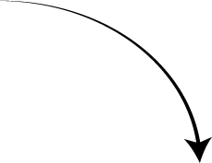
Reconstructing the phylogeny
Tips
Mutations
C
Units = nucleotide substitutions
GTCTCGGCTC
G
T
GTGTCGGCTA
0.02
GTGTCAGCTA
GTGCCAGCTA
Common ancestor
G
0.07
G,T
GGGCCATCTA
ATGTCAGCTA
Branch
Notes:
A few conventions:
tree extremities are called tips and correspond to sequences that have been observed/sampled
We can track the occurrence of mutations along the internal branches of the tree
Internal nodes represent putative common ancestors of the tips descending from the node
The root of the tree identifies the common ancestor for all sequences included in the tree

Slide 30
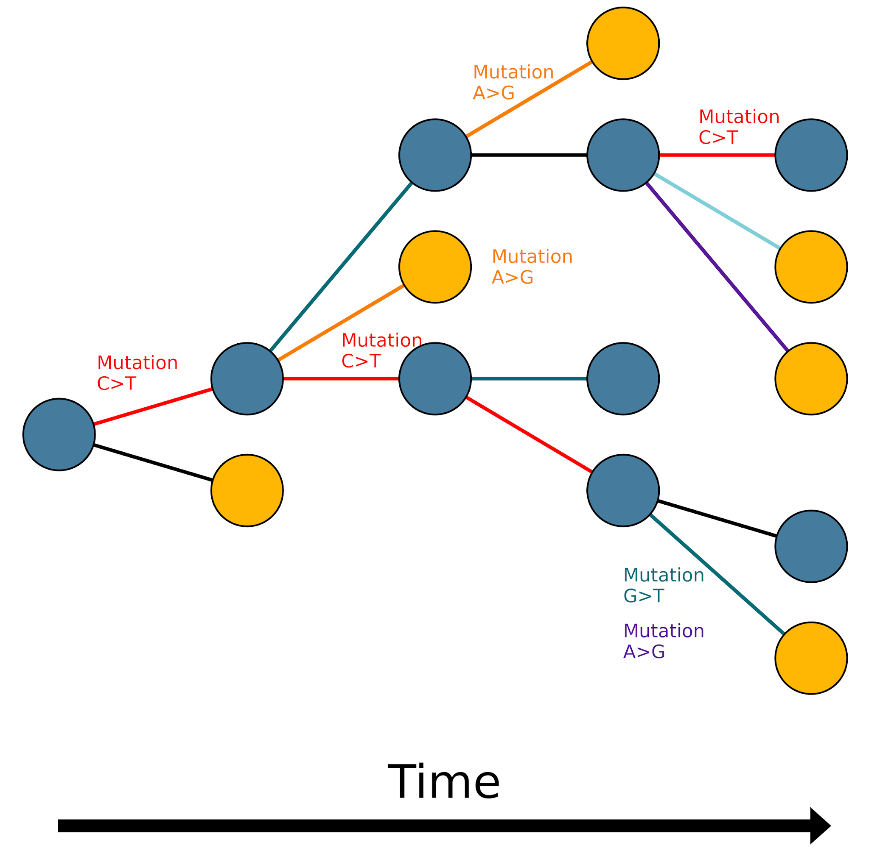
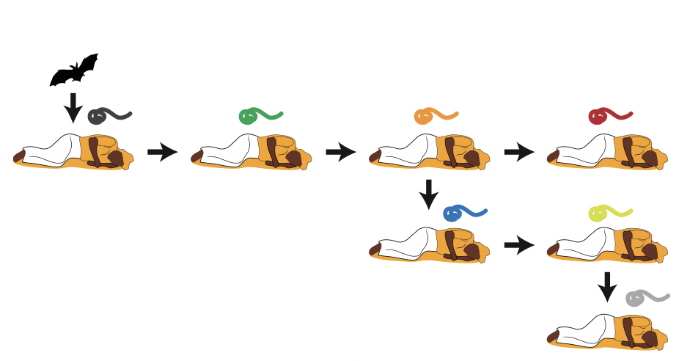
Why use genomic epidemiology?
What can phylogenetic trees tell us about transmission?

Slide 31
Why use genomic epidemiology?
What can phylogenetic trees tell us about transmission?
1. Identify the origin of epidemics/zoonoses
2. Understand transmission dynamics
Notes:
Reference between of lecture (slides 6-7 here)

Slide 32
Why use genomic epidemiology?
What can phylogenetic trees tell us about transmission?
1. Identify the origin of epidemics/zoonoses
2. Understand transmission dynamics
How can we accomplish these goals?

Slide 33
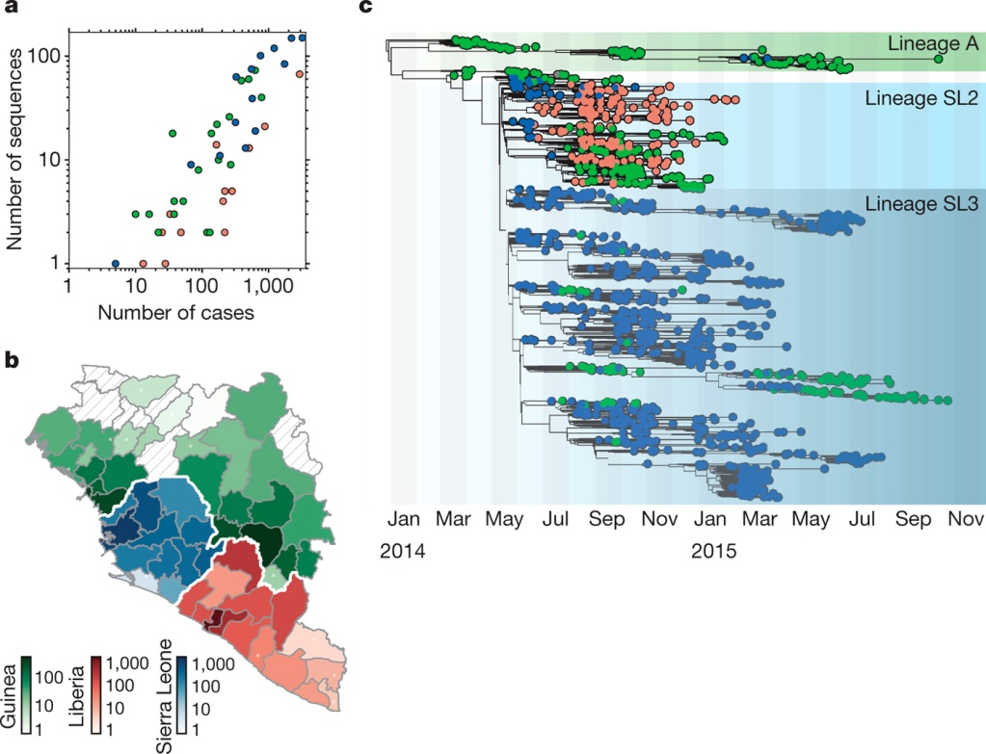
Why use genomic epidemiology?
Time resolution
When did the outbreak start?
Was the pathogen circulating for some time without us observing it?
Holmes et al. 2016.

Slide 34
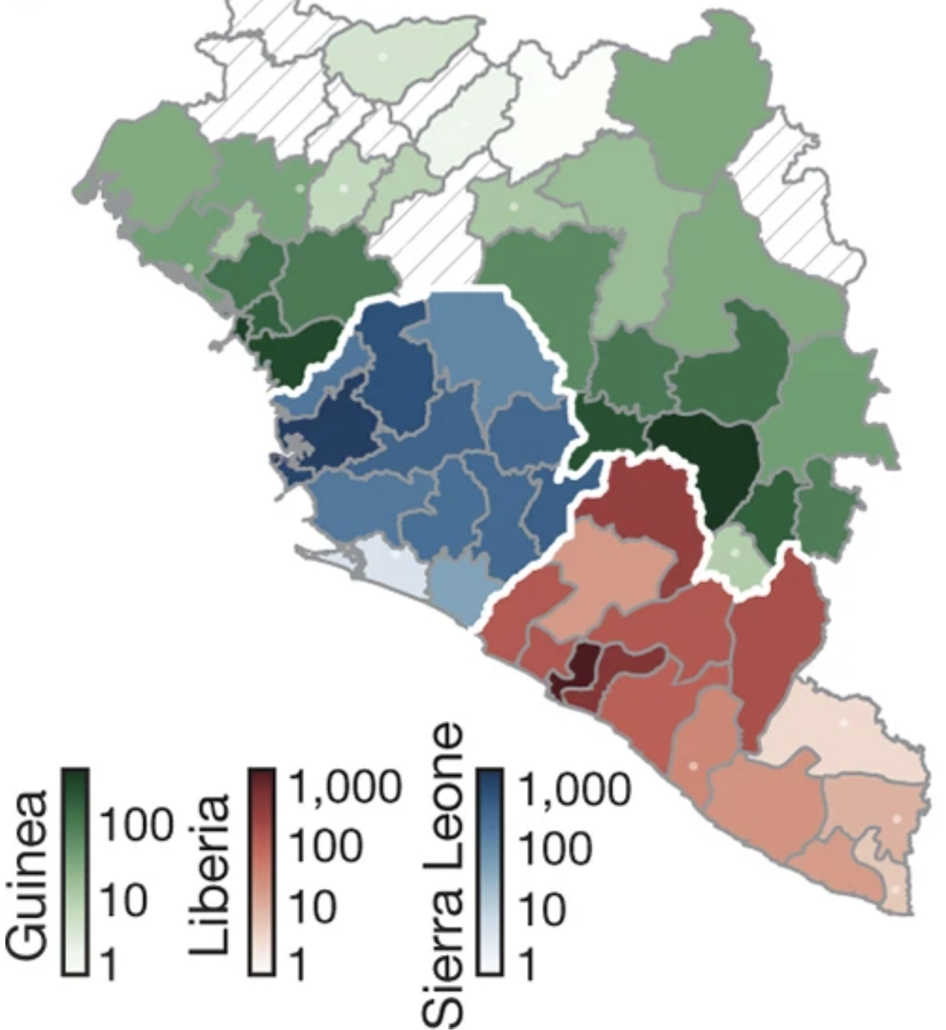
Why use genomic epidemiology?
Spatial resolution
Where did the outbreak start?
Are outbreaks in different areas related?
How is it spreading from area to area?
Will it help if we close borders?
Holmes et al. 2016.

Slide 35
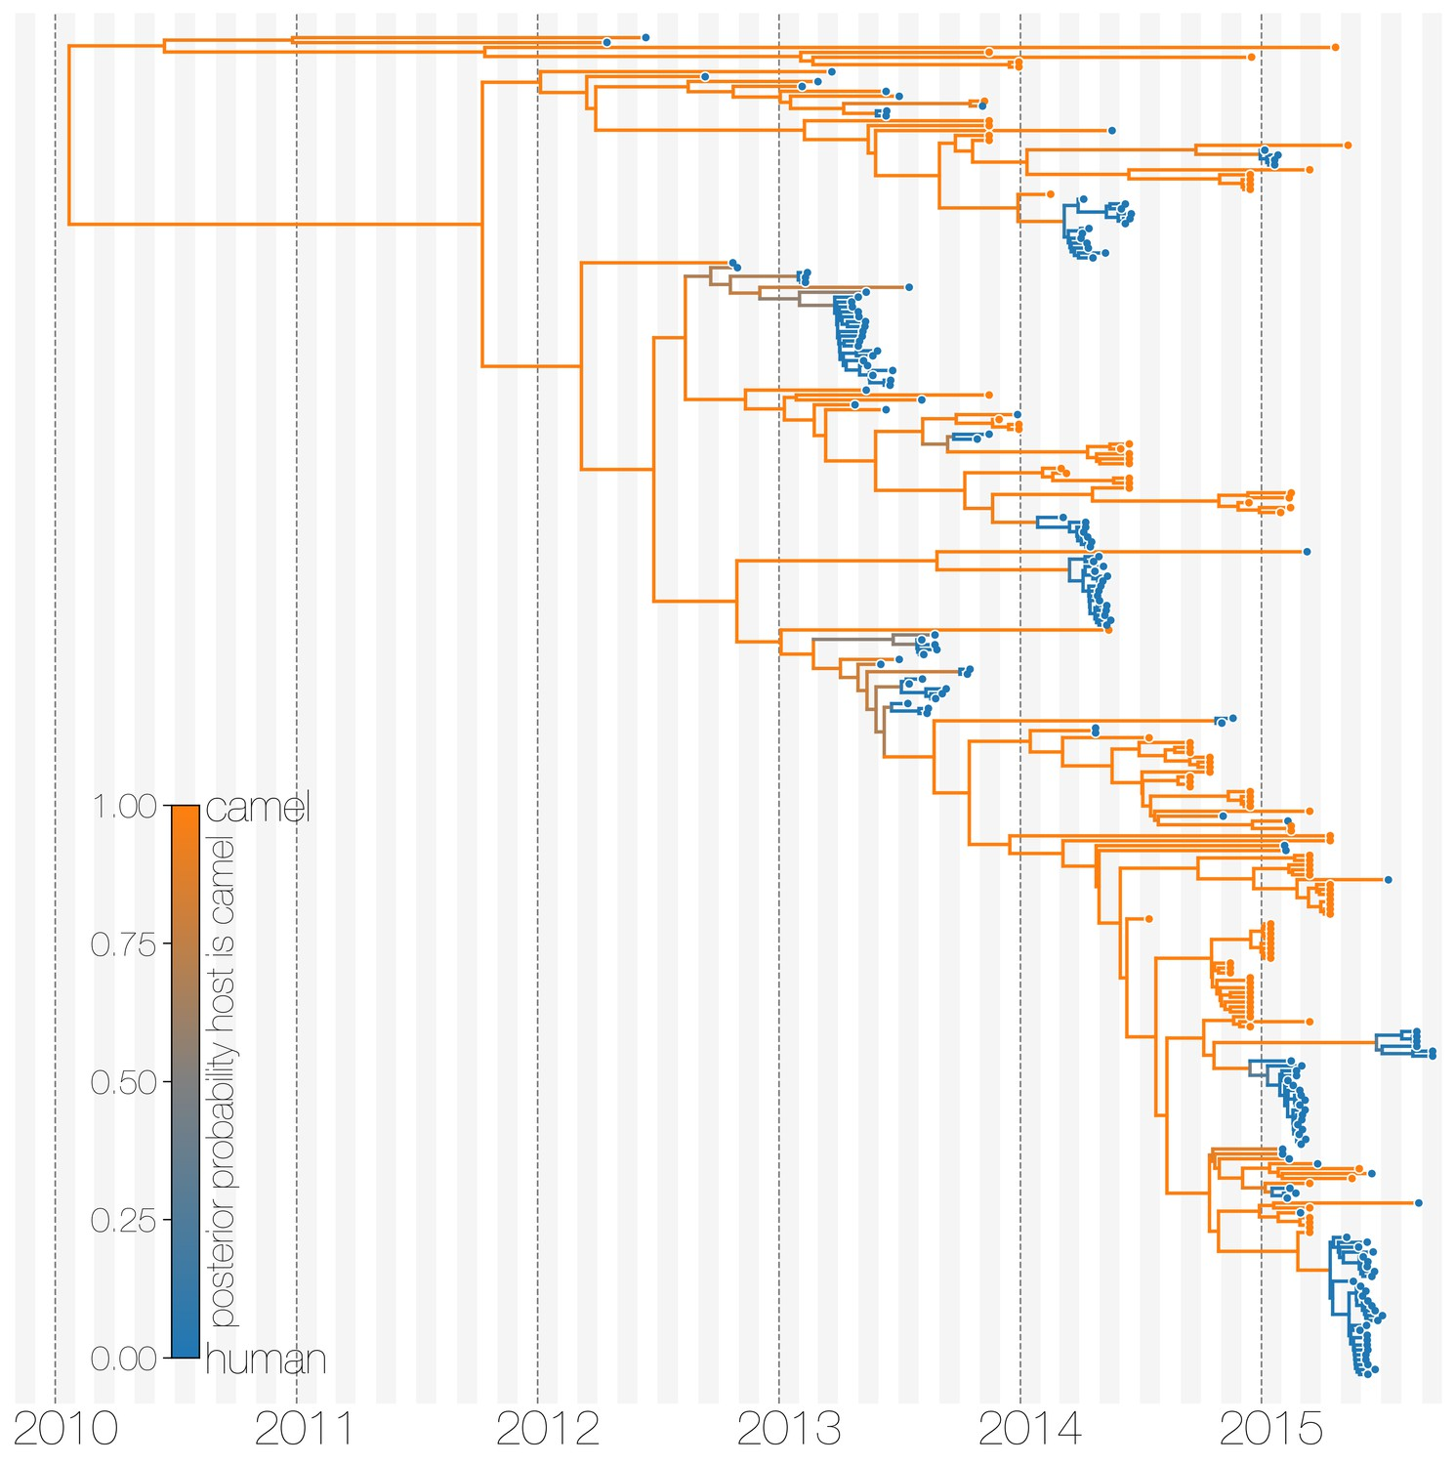
Host switches
Why use genomic epidemiology?
What is the animal source of a zoonotic spill-over event?
How many spill-over events were there?
How prevalent is it in the animal population?
How long has it been circulating in animals?
Is there an intermediate host?
Dudas et al. 2018.
Notes:
Feedback:

Slide 36
Summary
Genomic epidemiology helps us understand how infectious diseases spread in the population
Relies on pathogen sequencing to identify specific mutations
Tracks evolution of pathogens across time, space, and hosts

Slide 37
Why are some mutations transmitted? (and others not)
…
Notes:
See my comments on slide 18 – is there another figure you can use here?
(or perhaps it makes perfect sense and I will understand it once you write the script)

